Slide 1
Childhood Trauma
Monica Bellucci, M. Ed, LMHC
Clinical Coordinator, Western MA CIT- TTAC

Slide 2

Childhood Trauma
It is easier to build strong children than to repair broken men
-Fredrick Douglas

Slide 3
Learning Objectives
Participants will be able to identify childhood trauma and abuse and how that affects the child’s developing brain
Participants will gain knowledge on ACE’s (Adverse Childhood Experiences) and how it impacts all areas of functioning throughout a persons life span (medical, social, psychological, and criminal justice) and puts individual’s at a greater risk for justice system involvement.
Participants will be able to better understand attention deficit hyper activity disorder and identify how it can present in youths with trauma
Participants will be able to describe methods law enforcement can use to interact with youths in a trauma informed way.

Slide 4
What are some examples of possible childhood trauma
Divorce
Bulling
Abuse (sexual, physical, emotional, verbal)
Parental/Caregiver MH/SA
Parental/Caregiver incarceration
Neglect
Multiple foster homes
Poverty
Exposure to violence
Exposure to sexual experiences
`

Slide 5
Types of abuse Typically Occurred in Childhood
Physical abuse
Sexual abuse
Emotional/mental abuse
Neglect

Slide 6
What humans need for biological (species) survival
Food
Water
Shelter
Sex
Attachment

Slide 7
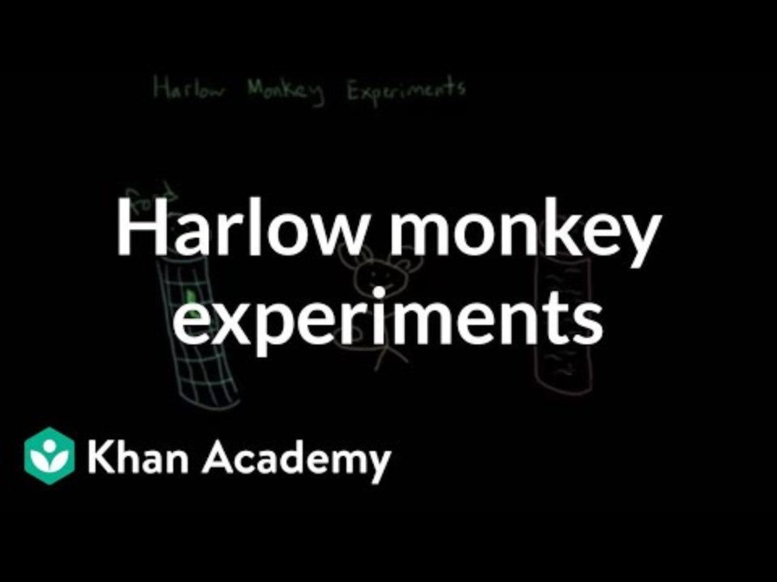
Attachment Harry Harlow Monkey Experiment
https://youtu.be/9wmvZH5lX_U

Slide 8
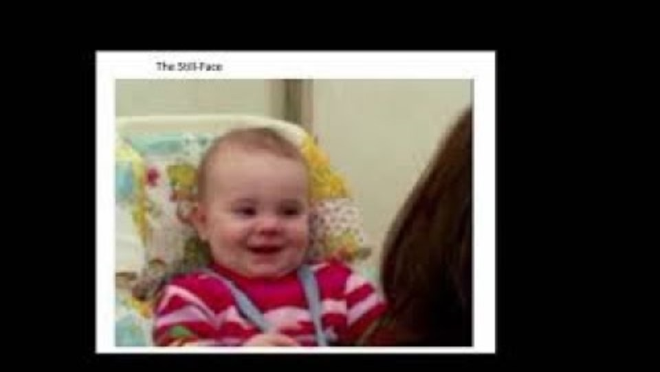
Neglect
Still Face Experiment
https://youtu.be/FaiXi8KyzOQ?si=KAv-LUZH6HwZSo13

Slide 9
The neocortex (review)
The cerebral cortex, the frontal cortex, is the front structure of our brain.
It contains most of our language abilities. This hemisphere of the brain processes information in an explicit, logical, analytical, and linear fashion.
It’s important for our functioning in a health lifestyle, that everything is integrated and linked.
This part of the brain is not fully developed until around age 25

Slide 10
Trauma and the Child Brain
https://www.tiktok.com/@docamen/video/7264267732814777643?is_from_webapp=1&sender_device=pc&web_id=7304316798345905710

Slide 11

What is Traumatic isn’t always Dramatic

Slide 12
Adverse Childhood Experiences (ACES) Questionnaire
Section 1
A household member swore at, insulted, humiliated, or put you down in a way that scared you OR a household member acted in a way that made you afraid that you might be physically hurt
Someone touched your private parts or asked you to touch their private parts in a sexual way that was unwanted, against your will, or made you feel uncomfortable
More than once, you went without food, clothing, a place to live, or had no one to protect you
Someone pushed, grabbed, slapped or threw something at you OR you were hit so hard that you were injured or had marks
You lived with someone who had a problem with drinking or using drugs You often felt unsupported, unloved and/or unprotected

Slide 13
Adverse Childhood Experiences (ACES) Questionnaire CONT
Section 2.
At any point since you were born…
You have been in foster care
You have experienced harassment or bullying at school
You have lived with a parent or guardian who died
You have been separated from your primary caregiver through deportation or immigration

Slide 14
Adverse Childhood Experiences (ACES) Questionnaire CONT
You have had a serious medical procedure or life threatening illness
You have often seen or heard violence in the neighborhood or in your school neighborhood
You have been detained, arrested or incarcerated
You have often been treated badly because of race, sexual orientation, place of birth, disability or religion
You have experienced verbal or physical abuse or threats from a romantic partner (i.e. boyfriend or girlfriend)

Slide 15

ACES
https://youtu.be/95ovIJ3dsNk?si=-5UnaWhcr4zAzS7Y

Slide 16
How the brain reacts to repeated trauma
The development and functioning of the three parts of the brain rely heavily on our childhood experiences. This includes early attachment figures, conditions in our environment, and traumas.
If we have ongoing or repeated threats in life, or on-going emotional/physical neglect, our brains become hypersensitive to cues that remind us of those traumatic experiences.
We can then have intense emotional reactions to cues, and our reptilian brain will then automatically activate our survival/trauma response system
Significant number of adults with Mental Health and Substance Use (at least 50%), their origin story is Adverse Childhood Experiences

Slide 17
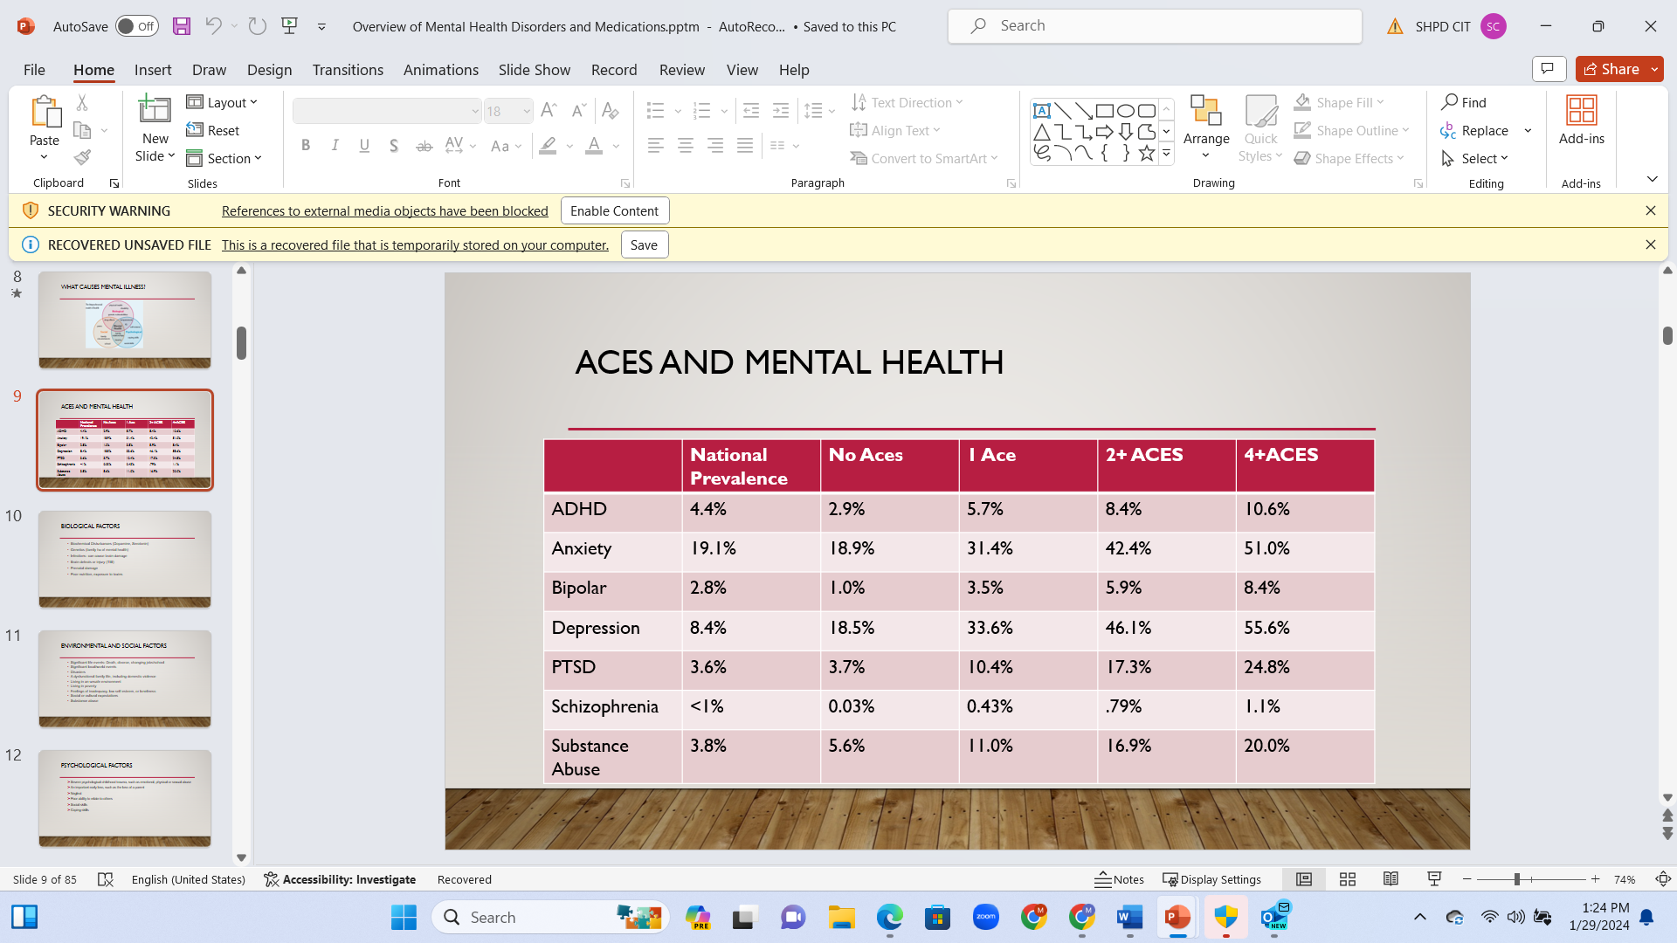

Slide 18
Childhood Disorders
ADHD, anxiety problems, behavior problems, and depression are the most commonly diagnosed mental disorders in children. Estimates for ever having a diagnosis among children aged 3-17 years, in 2016-19, are given below.
  ADHD 9.8% (approximately 6.0 million)
  Anxiety 9.4% (approximately 5.8 million)
  Behavior problems 8.9% (approximately 5.5 million)
  Depression 4.4% (approximately 2.7 million) ^{(CDC)}

Slide 19
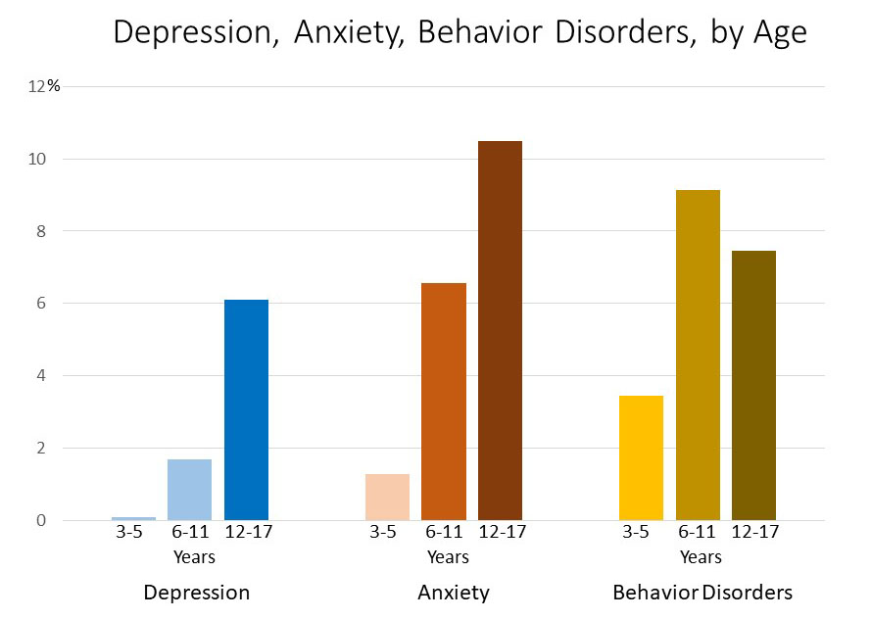
Childhood Disorders

Slide 20
Attention Deficit Hyper Activity (ADAH)
https://www.instagram.com/reel/Cvc-UjVtIVO/?igshid=MzRlODBiNWFlZA==

Slide 21
What is Attention Hyper Activity Disorder (ADHD)
ADHD affects the prefrontal cortex, the “human” part of our brains responsible for executive functioning
ADHD also affects the “mammalian” part of our brains which regulates emotions memory and behaviors.
  Often fidgets with or taps hands, feet, squirms in seat
  Often leaves seat in situations when remaining seated is expected
  Often runs about or calm in situations where it is inappropriate
  Often unable to unable to play or engage in leisure activities quietly
  Often “on the go” acting as if “driven by a motor”

Slide 22
ADHD
Often talks excessively
Often blurts out an answer before a question has been completed
Often has difficulty waiting their turn
Often interrupts on intrudes on others (butts into conversations, games, activities)

Slide 23
Activity
Blinking/Story telling

Slide 24
Trauma and Childhood Brain Development
https://www.tiktok.com/@mindbrainbodylab/video/7138822535709232426?is_from_webapp=1&sender_device=pc&web_id=7304316798345905710

Slide 25
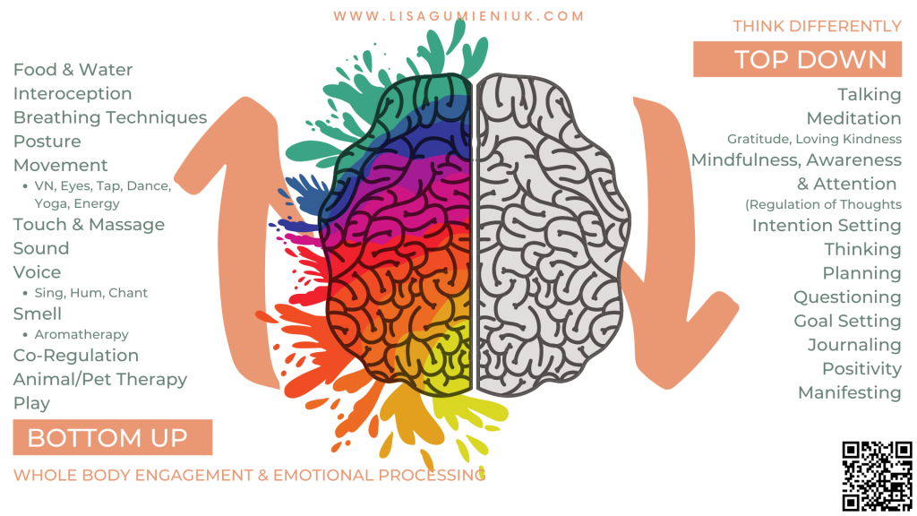
Top Down Bottom up

Slide 26
Direct vs indirect messaging
Direct verbal communication. Direct verbal messaging processes through frontal lobe
Indirect messaging is processed thought the emotional center and the brain stem. This is all the other types of communication, tone, body language, volume, facial expression etc
When a person is experiencing a trauma response, they are operating primarily from their emotional center and brain stem.

Slide 27
Slow simple repeat
Slow
  Breathing
  Communication
Simple
  “KISS” (keep it simple stupid ☺)
Repeat
  Often in the same slow simple communication

Slide 28
Regulate, relate, reason
  Step 1: Regulate
  Breathing
  Walking
  Tapping
  Water
  Step 2: Relate
  Validate feelings (not behaviors)
  Identify wants, needs and feelings
  Use reflective language
  Step 3: Reason
  Talk about the specific topic

Slide 29
Bottom up approaches
Breathing
Water
Soft tone of voice
Soft posture
Hearing and validation of emotions
Sensory input or elimination
grounding exercises- smells, tastes sights sounds touch
Trauma stored in body and emotion center of brain
Predictability, Safety, and Control

Slide 30
Increase bottom up interventions for children
War heads (strong tasting)
Playdough
Muscle tension (wall sits, planks)
Smells (essential oils on cotton swab)
Playfulness/Humor

Slide 31
Decrease top down interventions
Limit talking
Increase silence
Short declarative sentences
Ask permission when ever you can
Explain what you are doing or going to do or what will happen next

Slide 32
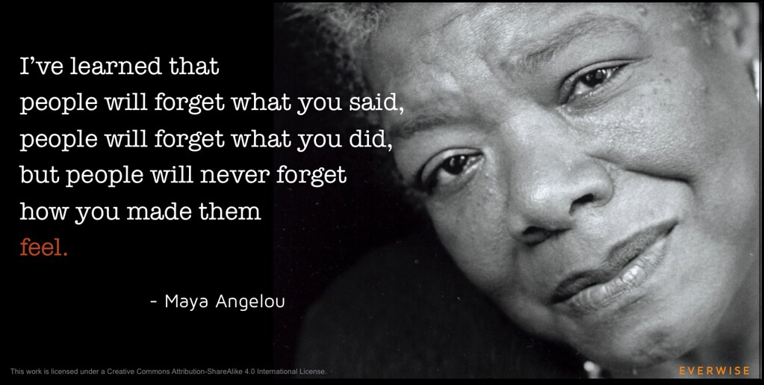
Trauma and Children

Slide 33
THANK YOU
Questions???

